Slide 1


FPT UNIVERSITY
ASSIGNMENT_02 Report
Class : AI18C
Group: 3

Slide 2


Đỗ Thị Quỳnh Nga
Lê Quốc Chính
MEMBERS
Cao Ngọc ý
Nguyễn Trọng Khoa
Nguyễn Tấn Thắng

Slide 3

01. Project Overview
02. Idea
03. Program
CONTENT

Slide 4

01. Project Overview

Slide 5
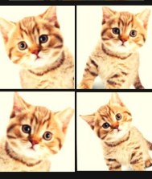
Image Augmentation
Input
•Image processing methods (or modify the configuration files)
•Number of expected output images.
Output
•Images after processing.
Learning rule
•PIL / OpenCV / etc.
•List, Dictionary, random.
•Image Processing methods combination.

Slide 6
02. Idea

Slide 7

IDEA
_ Create functions to transform the image
+ Cao Ngọc Ý
+ Nguyễn Trọng Khoa
+ Đỗ Thị Quỳnh Nga
_Optimize user selection
+ Nguyễn Tấn Thắng
_Create layout for the program
+Lê Quốc Chính

Slide 8
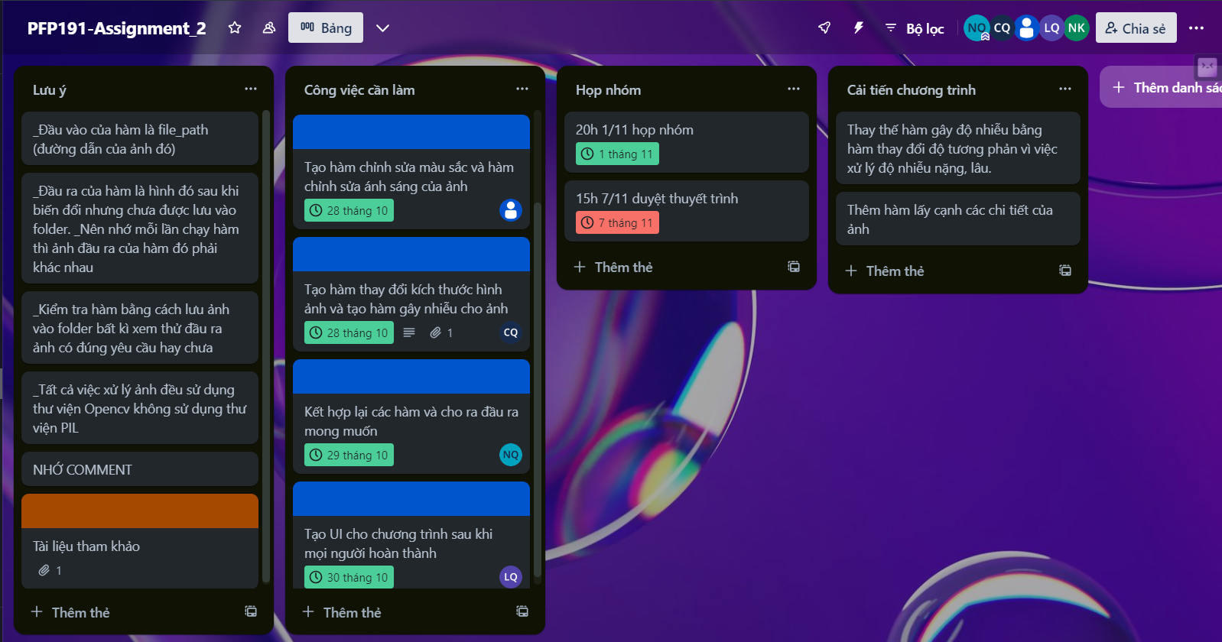
Teamwork

Slide 9
03. Program

Slide 10


3.1 Functions to transform the image
_Crop an image:
+Crop a random portion of the original image, with the size and cropping positions determined randomly.

Slide 11
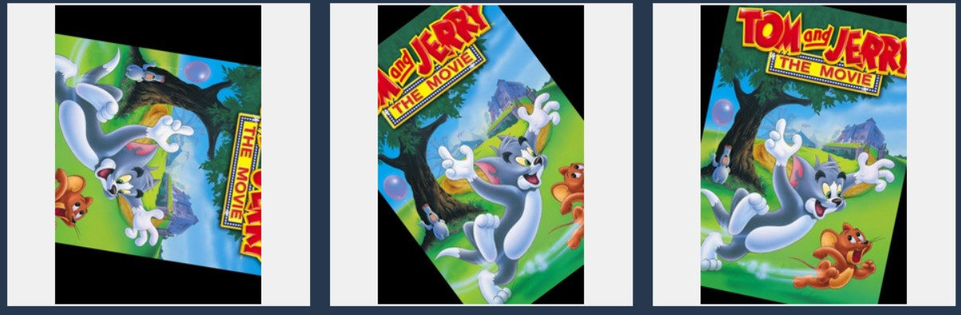
_Rotate an image: cv2.getRotationMatrix2D, random.uniform
+Randomly rotate an image with a random angle of rotation around the image's center.

Slide 12



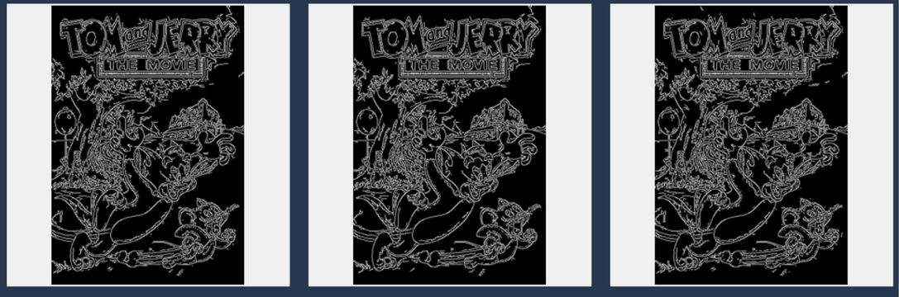
_Change the color of an image : cv2.cvtColor, random.choice
_Change the brightness of the image : numpy, random.randint
_Edges of the image : cv2.Canny

Slide 13


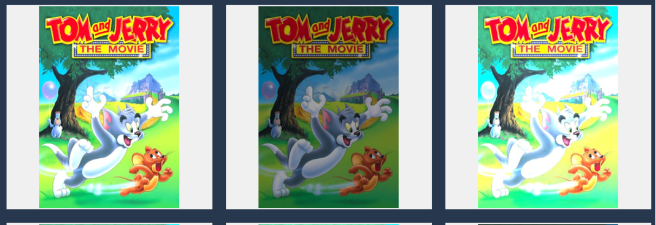
_Change the size of an image: cv2.resize
_Adjust the contrast of an iimage: cv2.convertScaleAbs

Slide 14

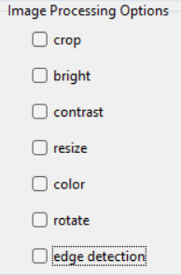
3.2 Optimize user selection
_Input:
An Image and options that the user chooses
_Output:
The image is transformed from the selections

Slide 15

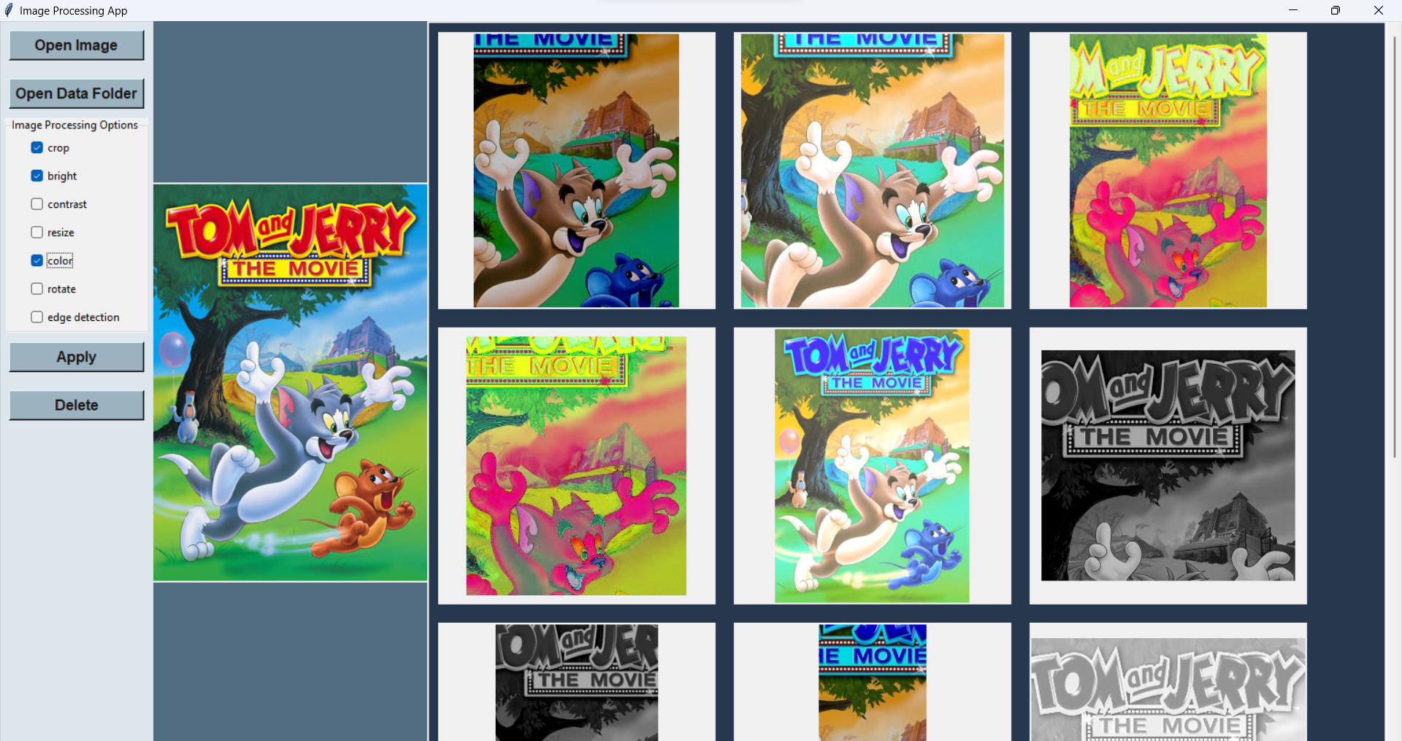
3.3 Layout of the program

Slide 16
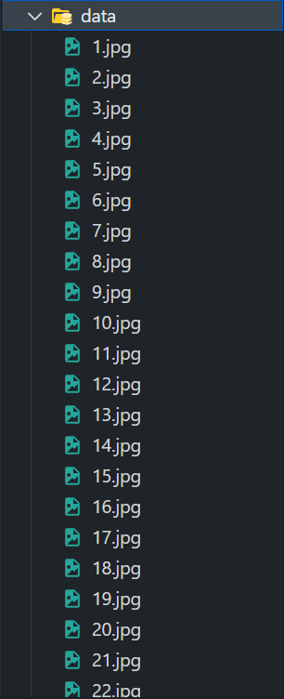
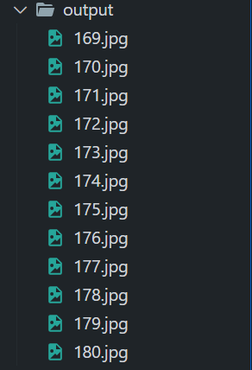

Slide 17
SUMMARY
The program satisfies user requirements when transform images
The program interface is easy to use

Slide 18
THANKS

